Slide 1
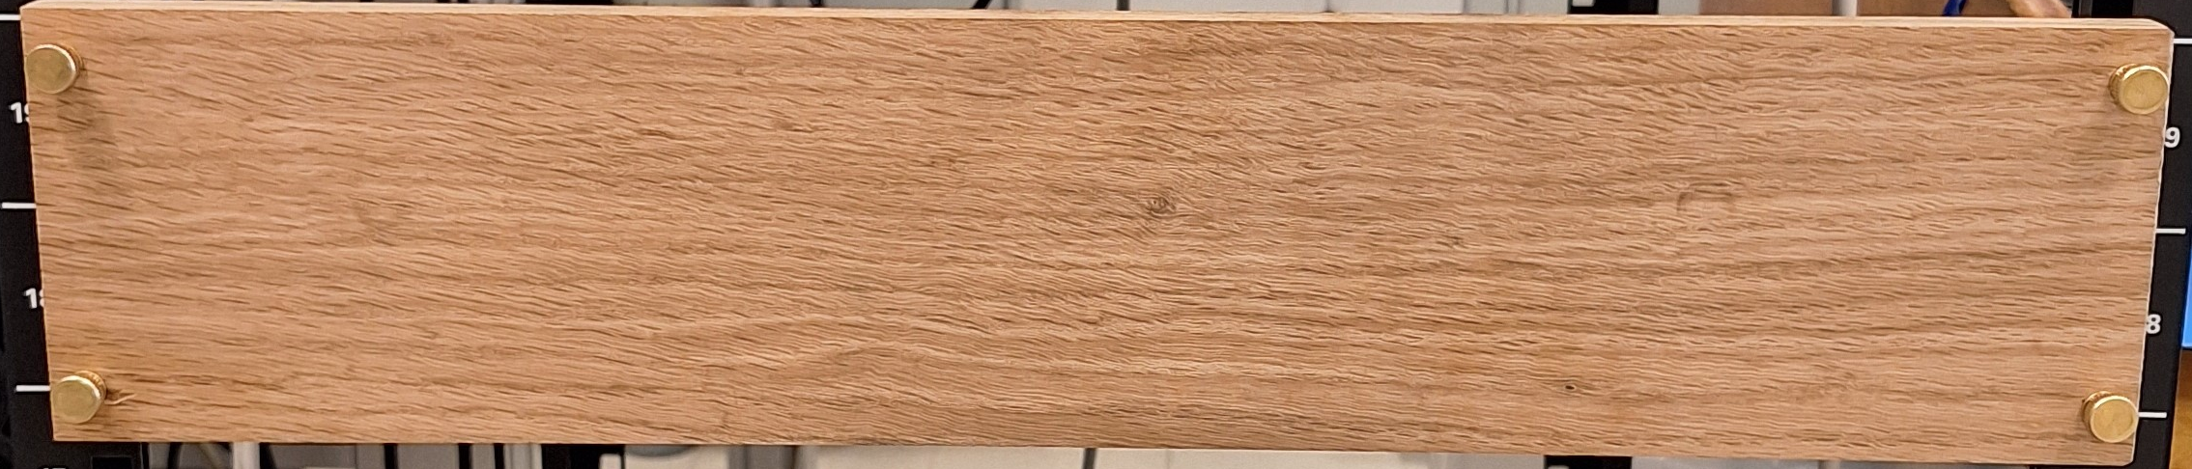
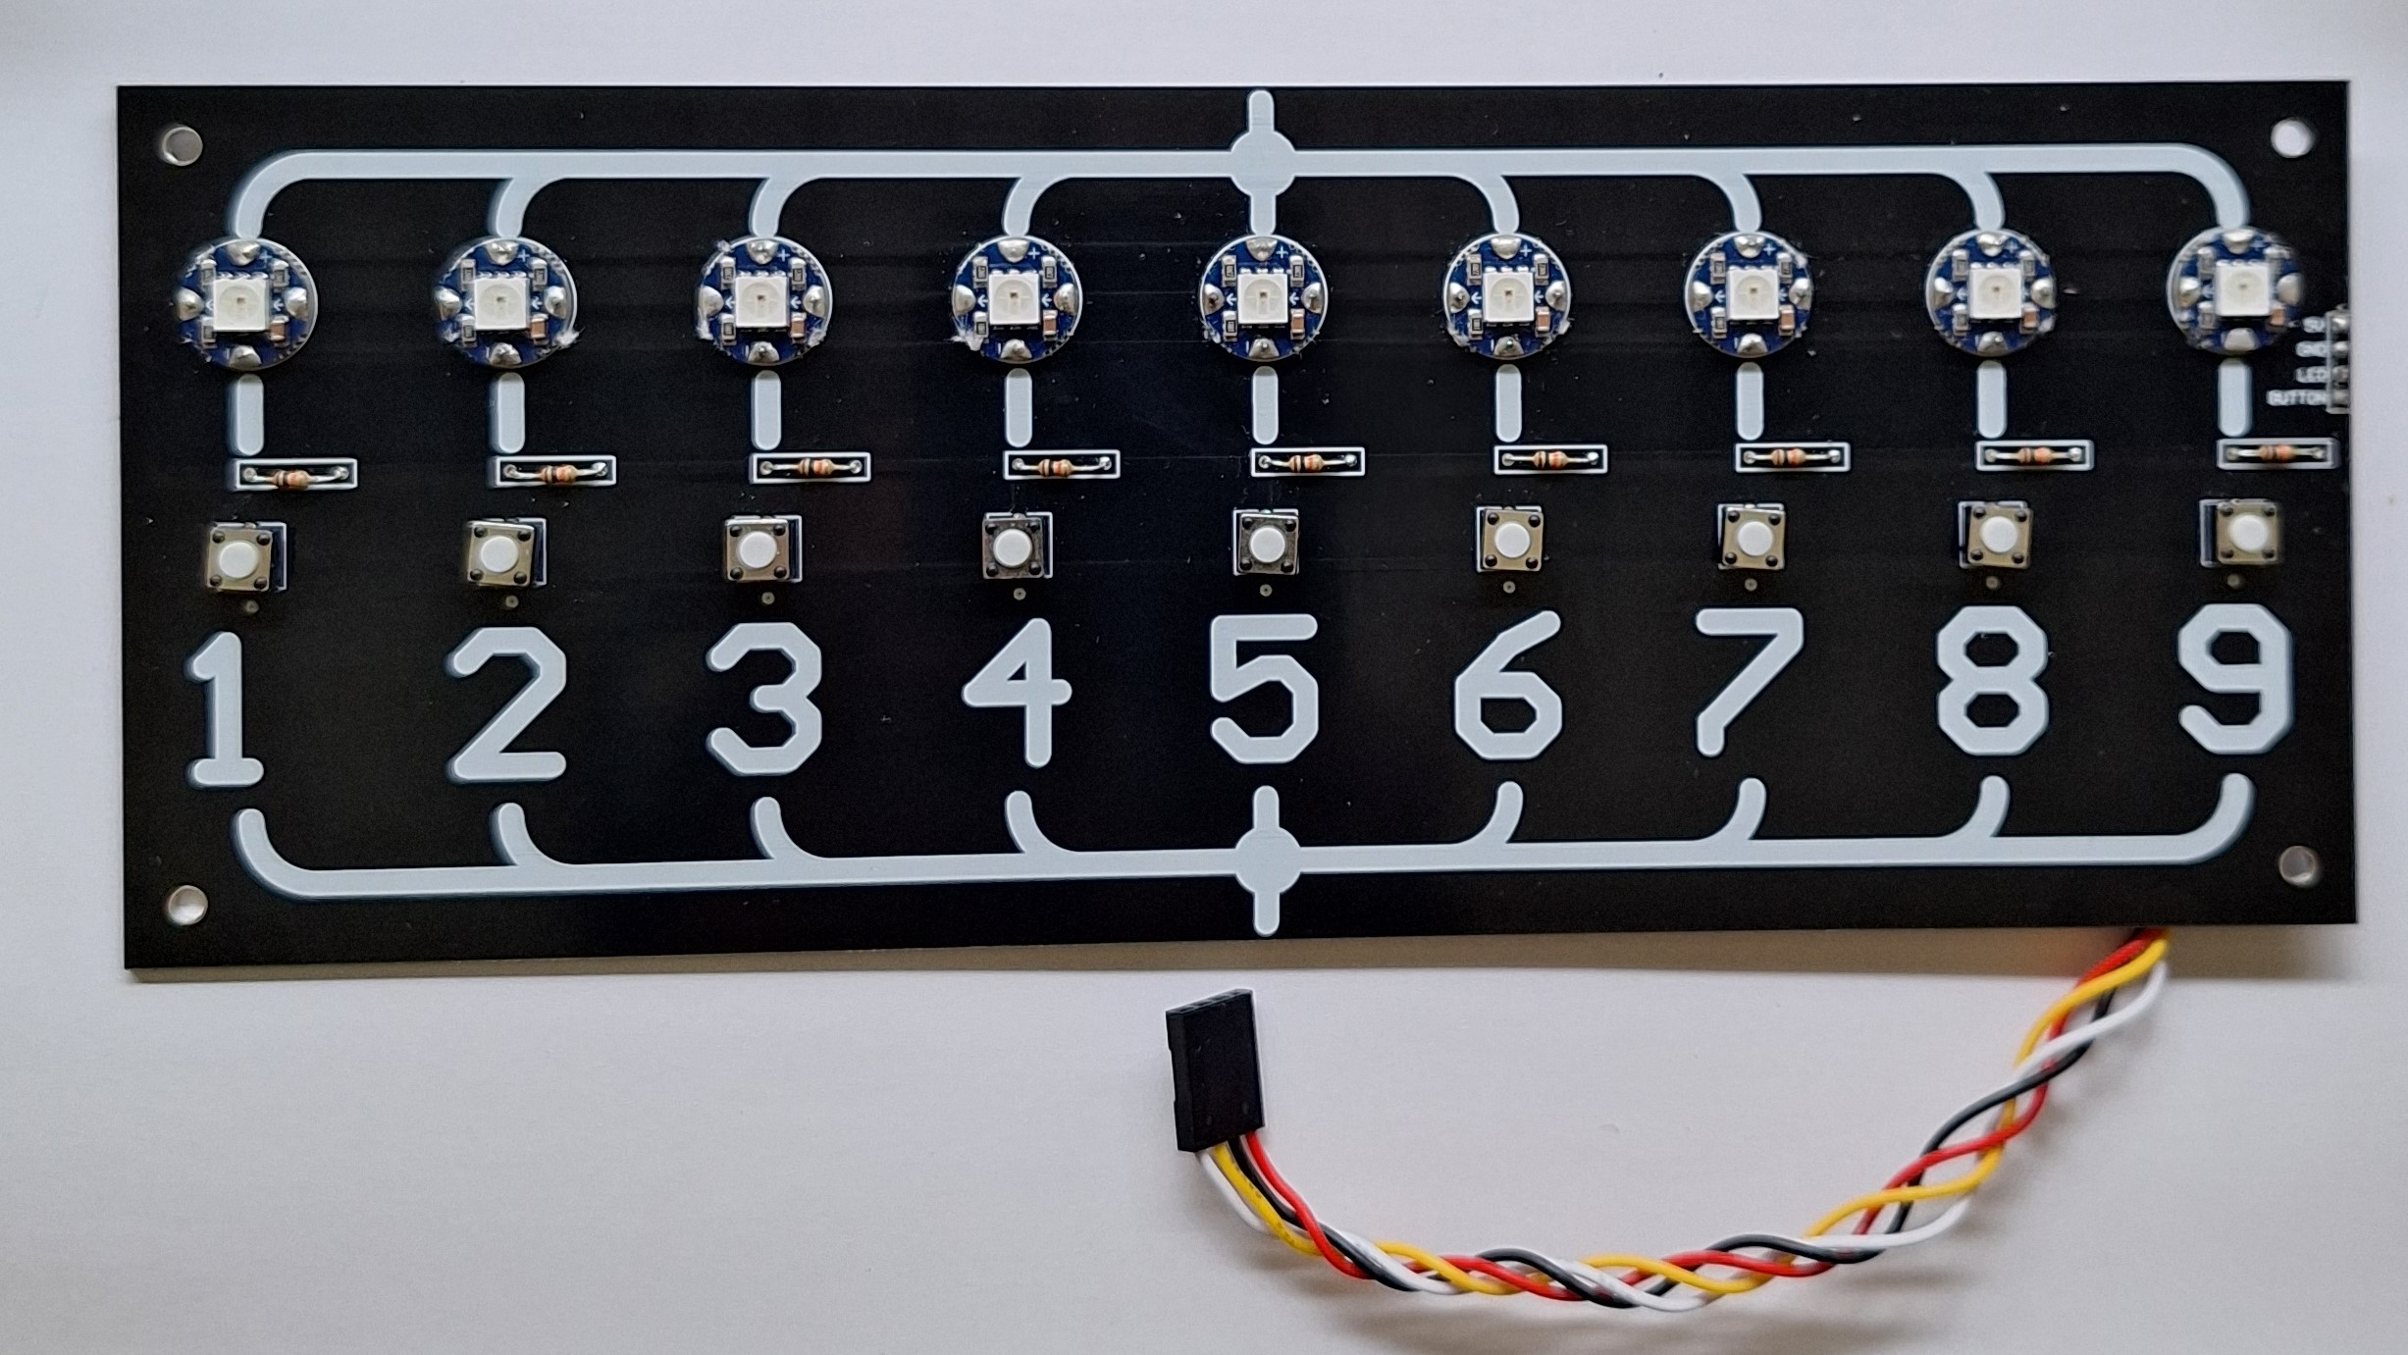
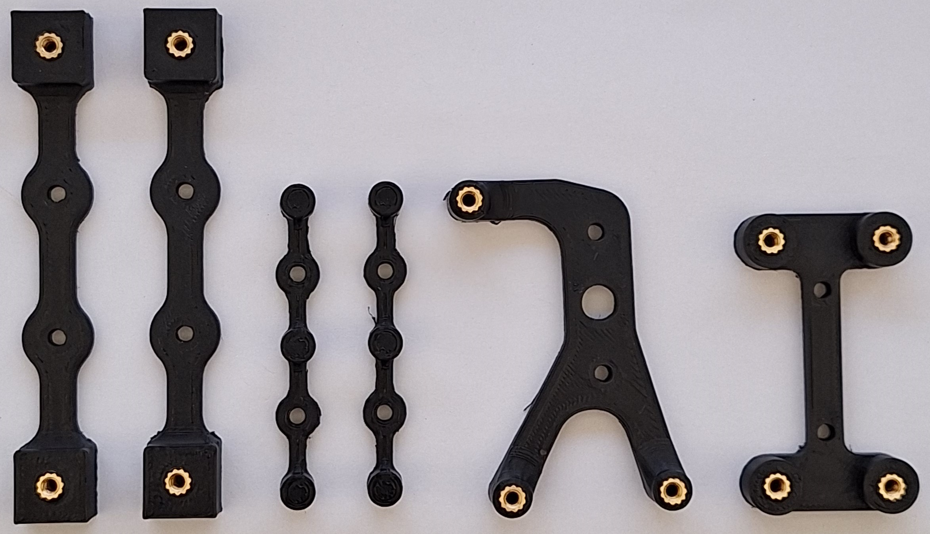
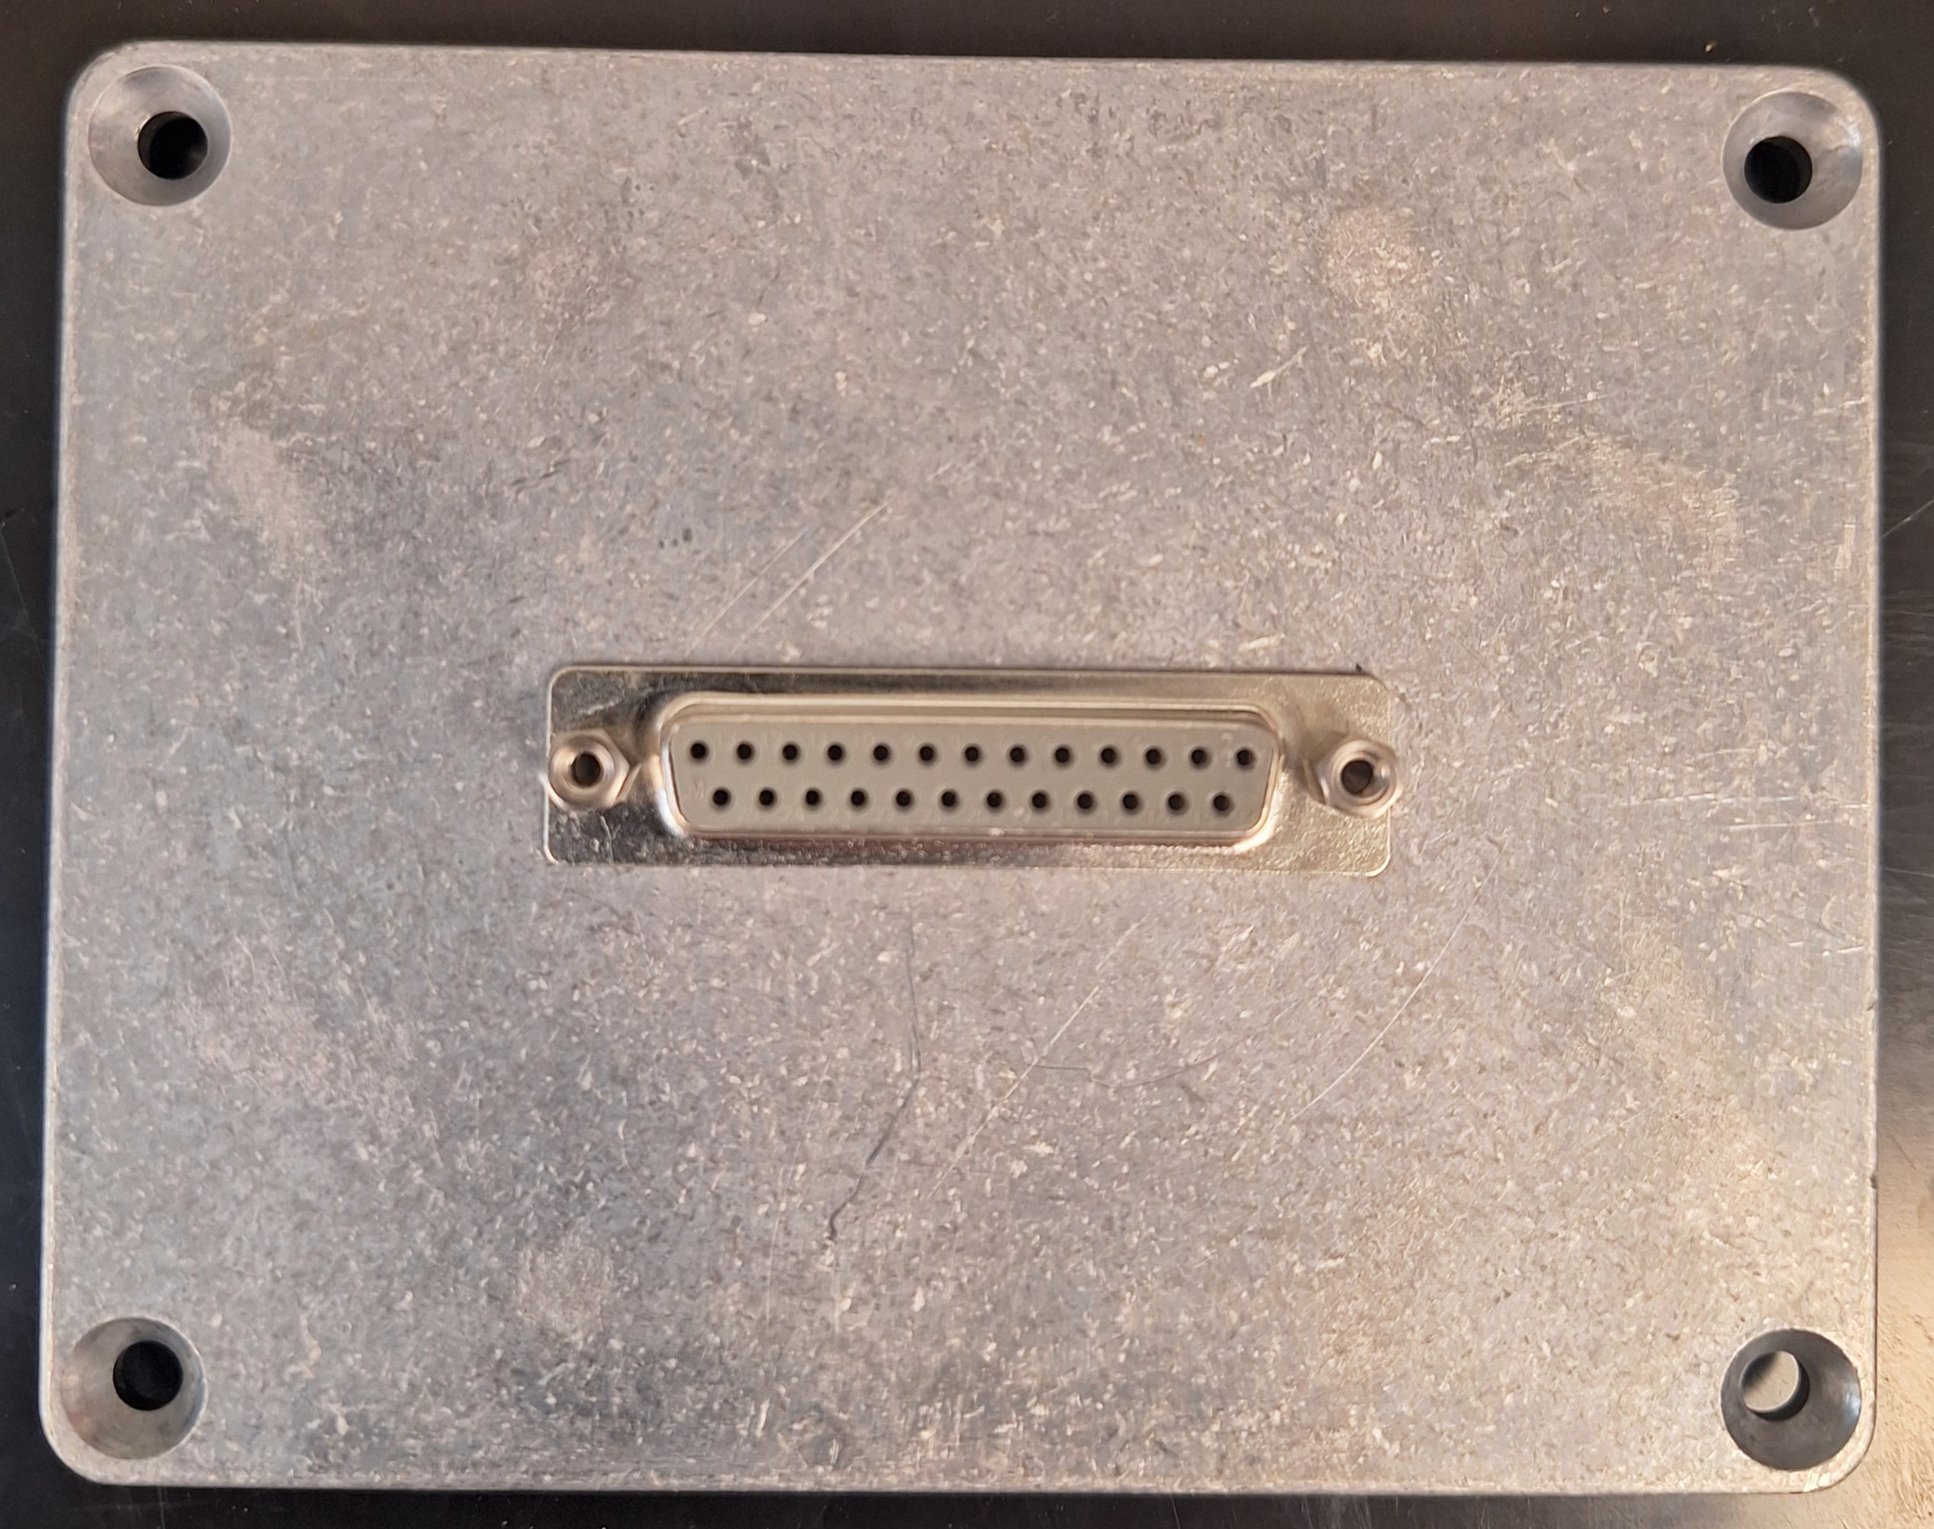
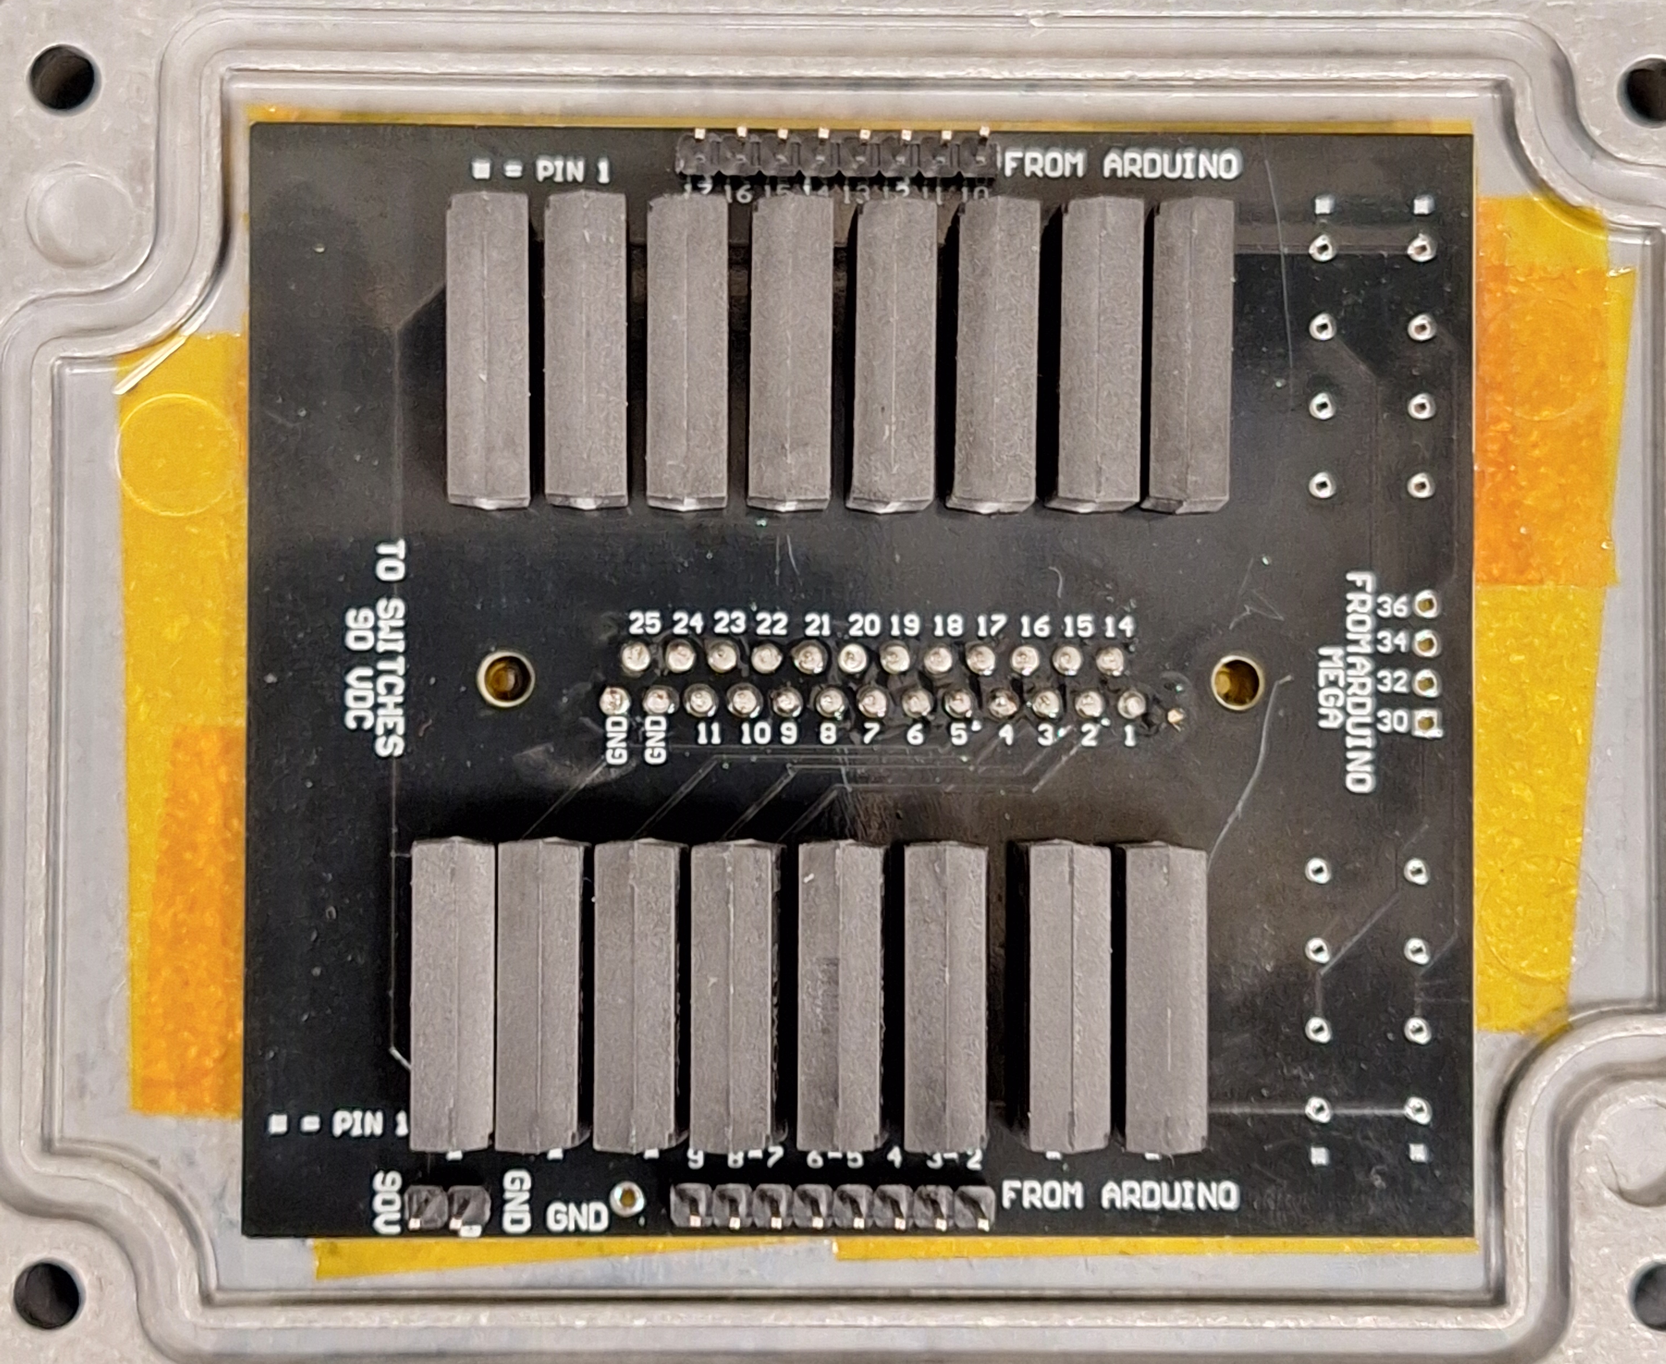
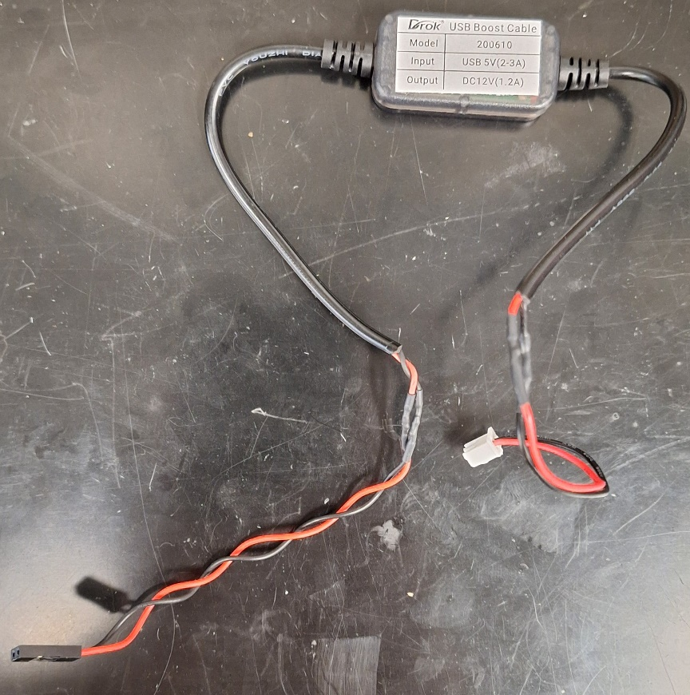
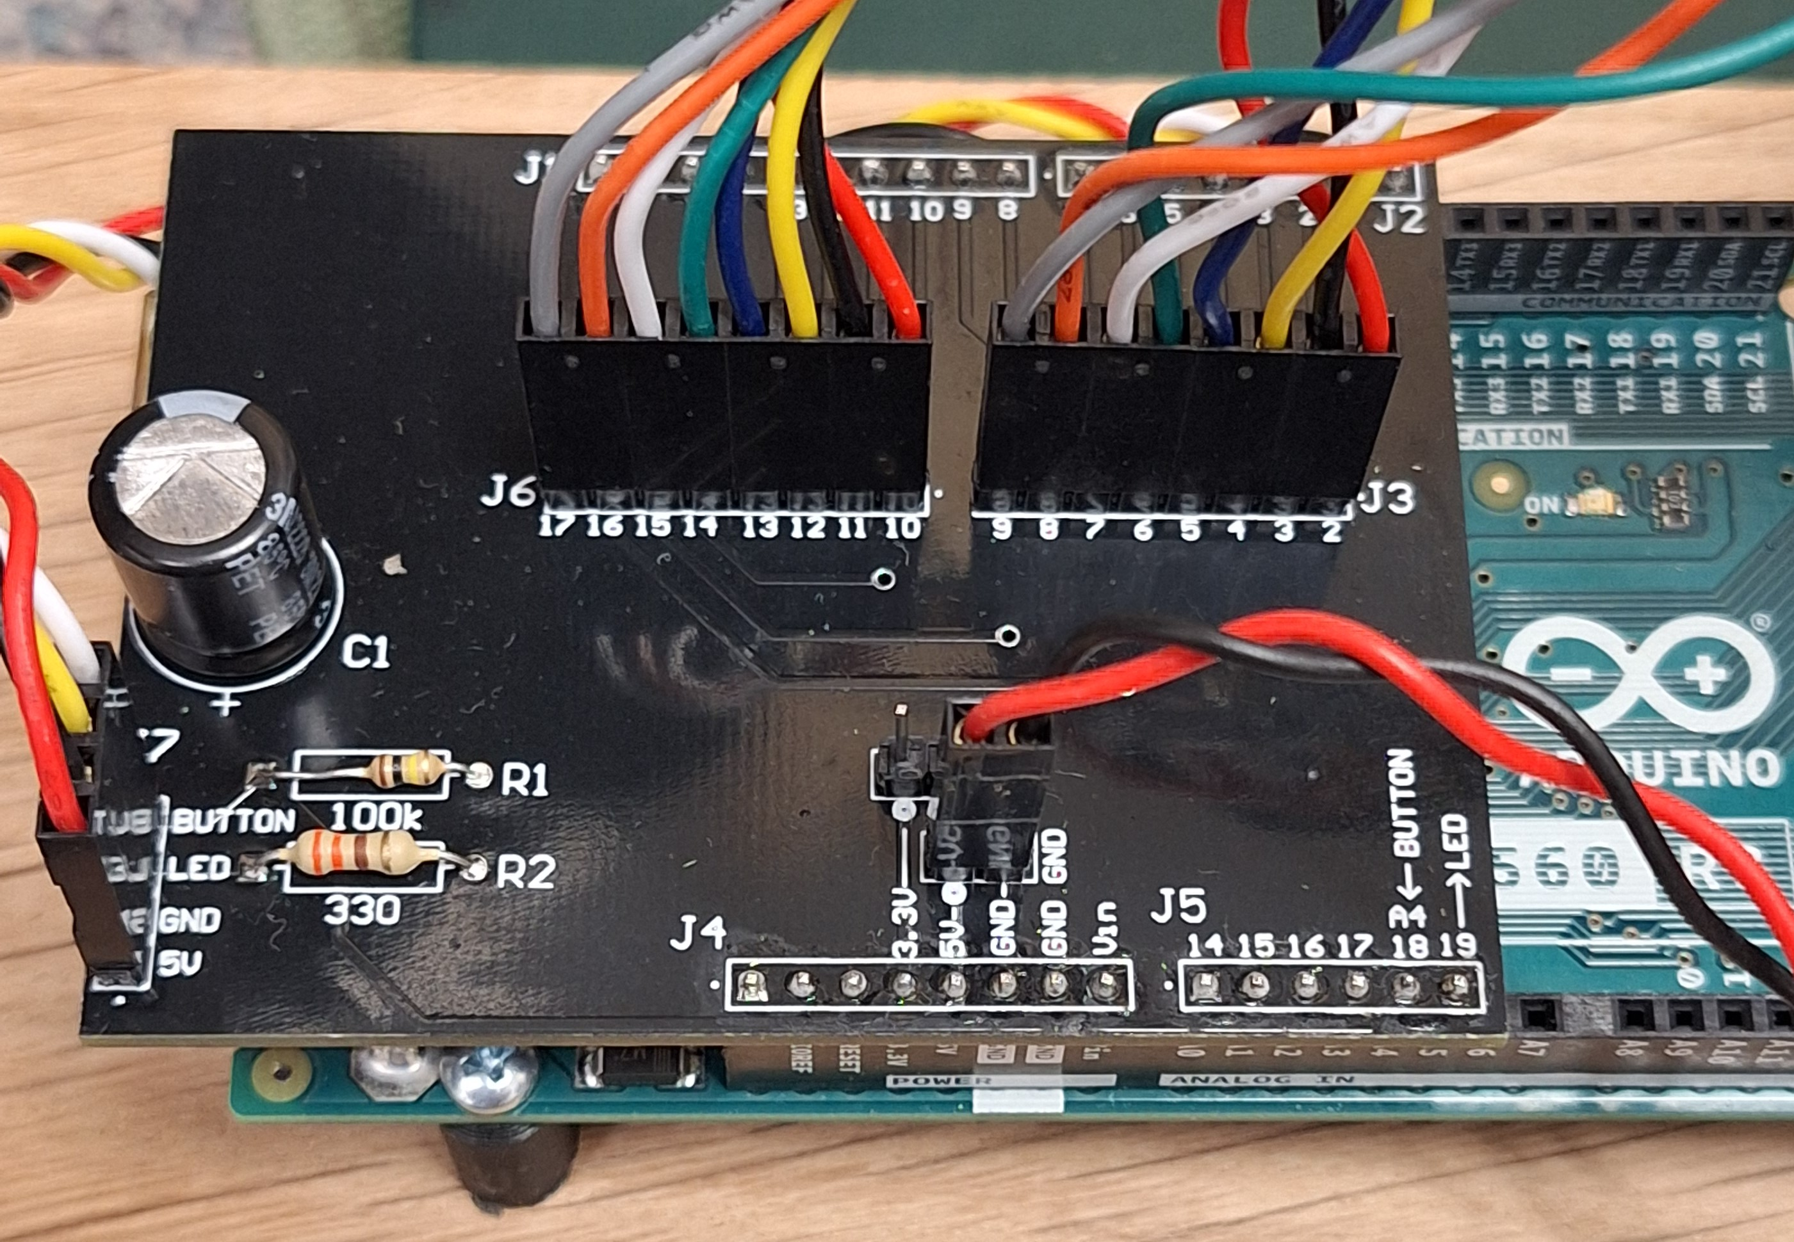
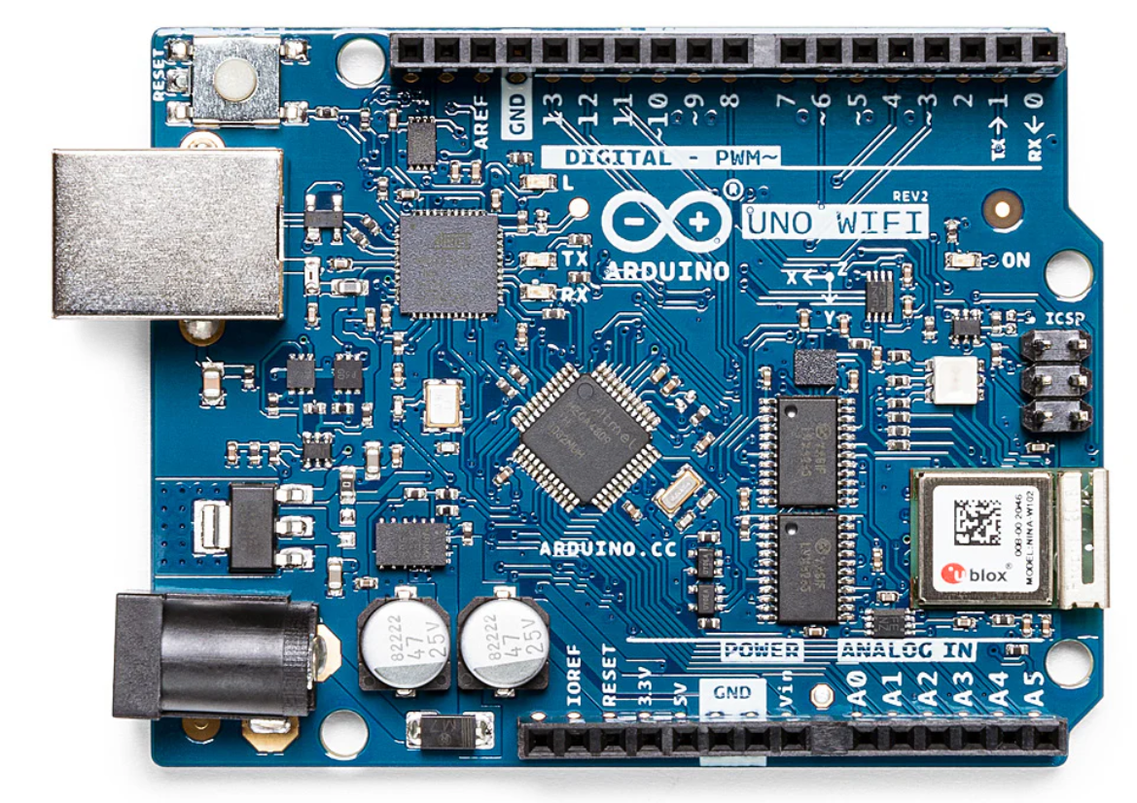
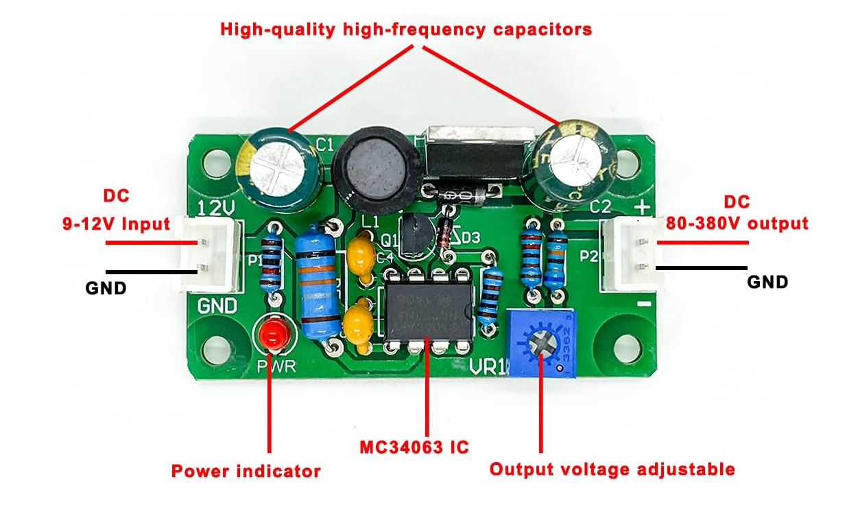
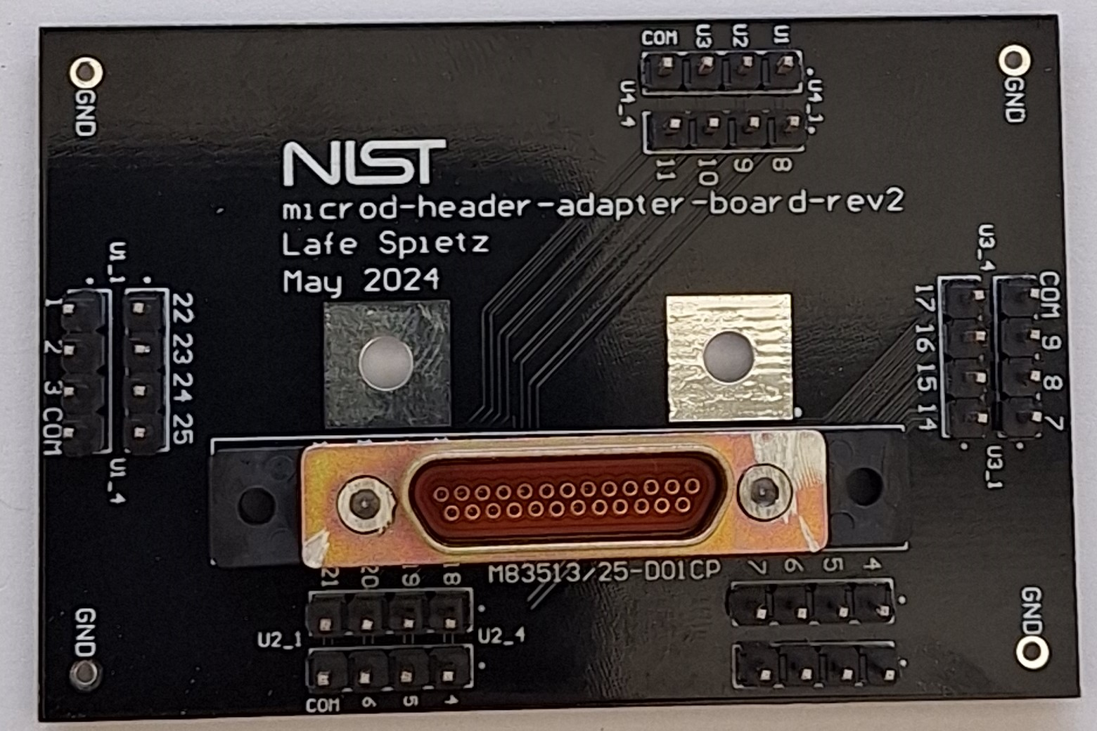


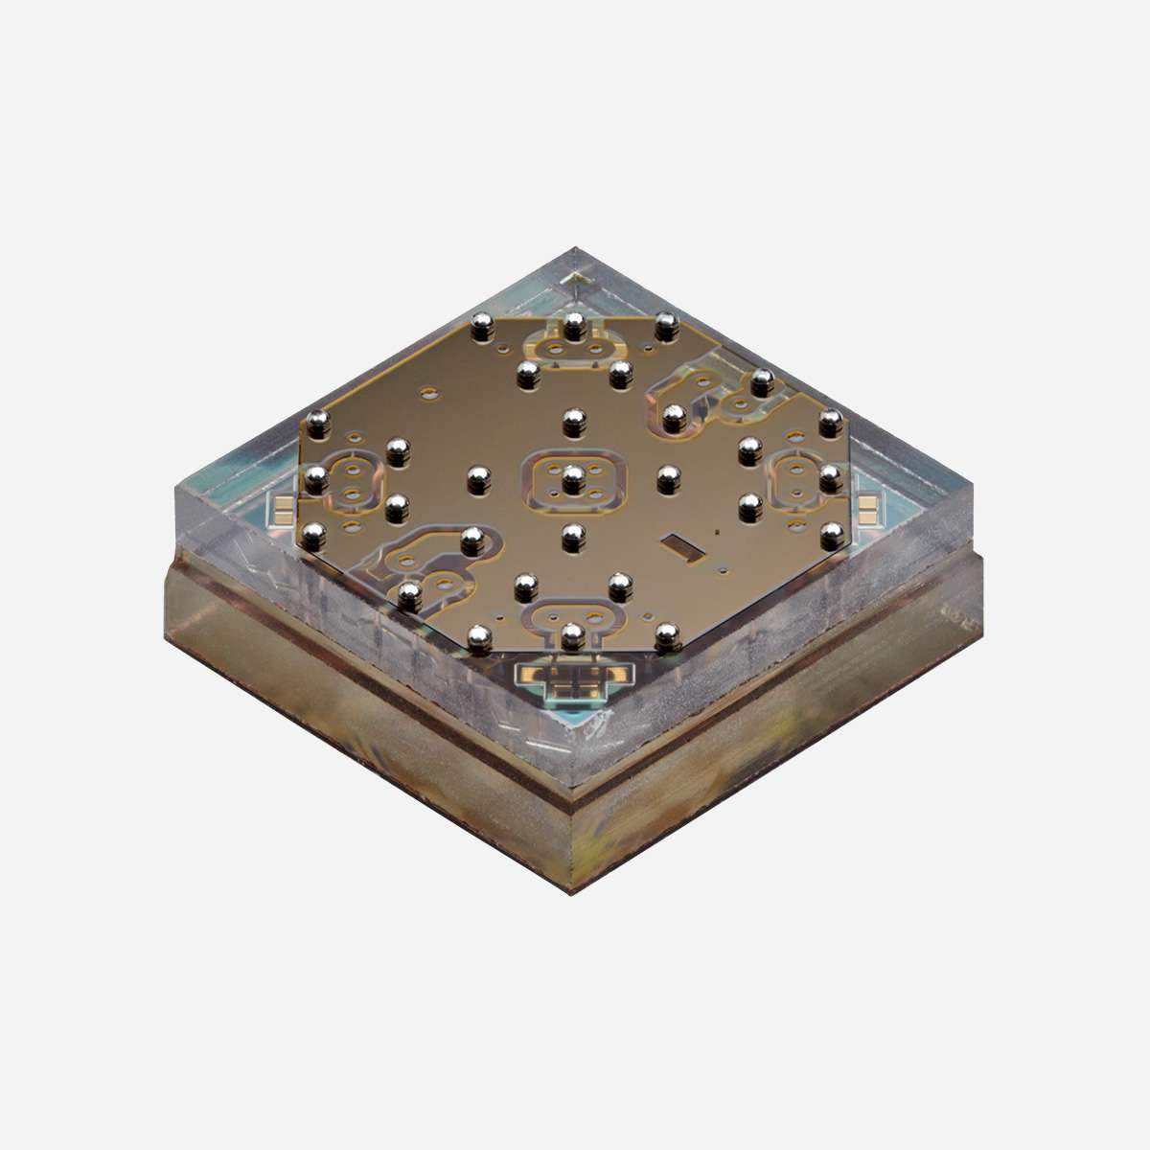





Rack Mount Wood Boards
3d printed parts
Control Panel Circuit Board
90 V Control Lines
90 V Power
5 V Power
Lights Signal
Button Signal
Custom Metal Box
DB25 Relay Circuit Board
5V to 90V Boost
Arduino Shield
Arduino UNO
90 V Control Lines
5V Control Signals
90 V Control Lines
MEMSDuino
Cold MicroD Breakout
RF MEMS Switches
0.01 kelvin Dilution Refrigerator
Control Software

